Slide 1

DriverPass System Analysis
Justin Perez
Notes:
As a speaker, Please focus on each top bullet point specifically then go a little more in depth as you go downwards on the list.

Slide 2

System Requirements
Functional
User Account Management
The system allows users to create edit or delete their own accounts.
Scheduling and Appointment
Users can change and modify their own Schedule
Non-Functional
Security
The system must encrypt all sensitive Data
Performance
The system should take within 2 seconds to load.
Notes:
[In your speaker notes, include an explanation of the different requirements you determined for DriverPass’s system. What are the functional requirements you selected to describe? What are the nonfunctional requirements you selected to describe? Be sure to explain how these requirements meet DriverPass’s needs.]
Functional requirements are features that brake be functional for the users. Explain functional requirements are like the radio in a car as well as the adjustable seats. Explain Non-functional requirements are like the engine and brake pads in a car.
If they are confused on security and why encryption is important tell them if your housekey opened every house there would be no purpose of the key which is why every house key is different.

Slide 3
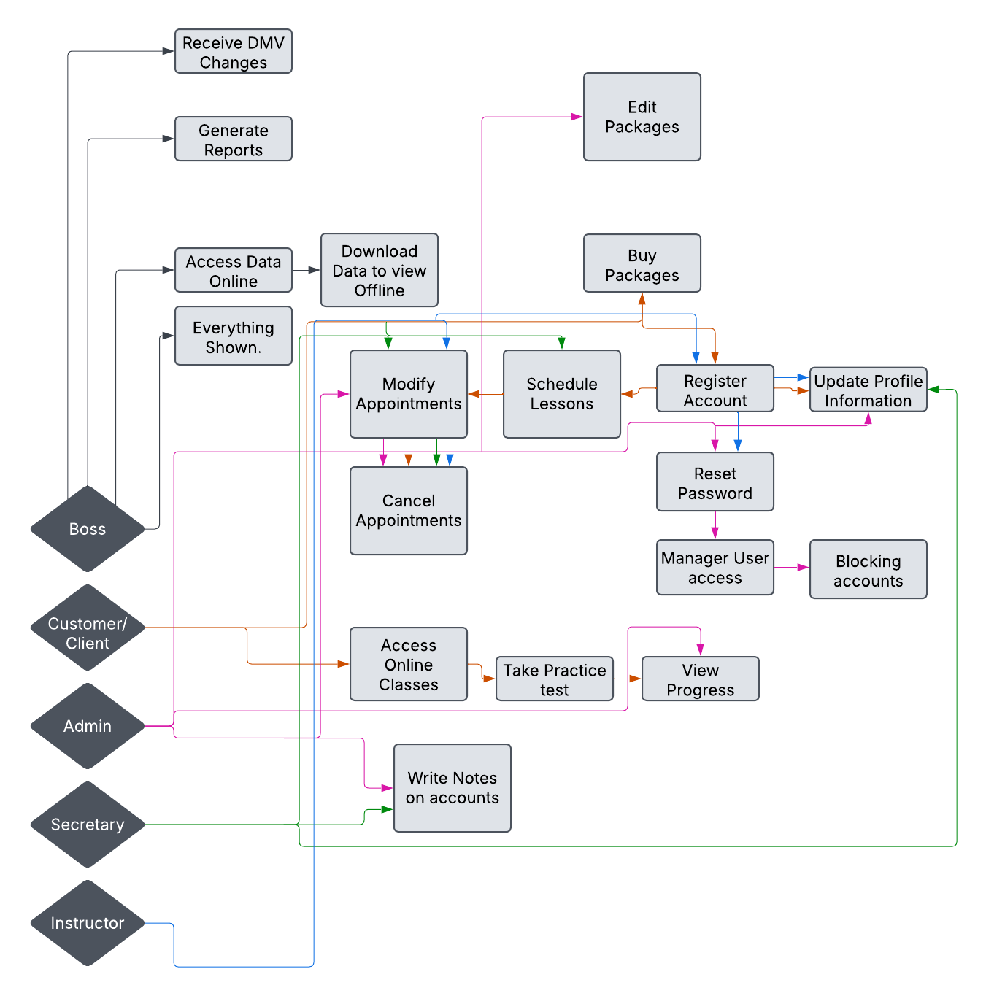
Use Case Diagram
Notes:
[Explain your diagram. Who are the different actors in the system? What are the different use cases? How did you account for DriverPass’s needs in your design? In your explanation, keep your audience in mind. Avoid the use of terms like “actors” and “use cases” in your explanation.]
Give emphasis on the boss and how he will have access to everything even though it’s not connected.
Explain that everyone has a different part that’s connected. line, if you follow the instance, you can see where it belongs. For instance, if you follow the green secretary line you can see it can write notes on accounts.

Slide 4
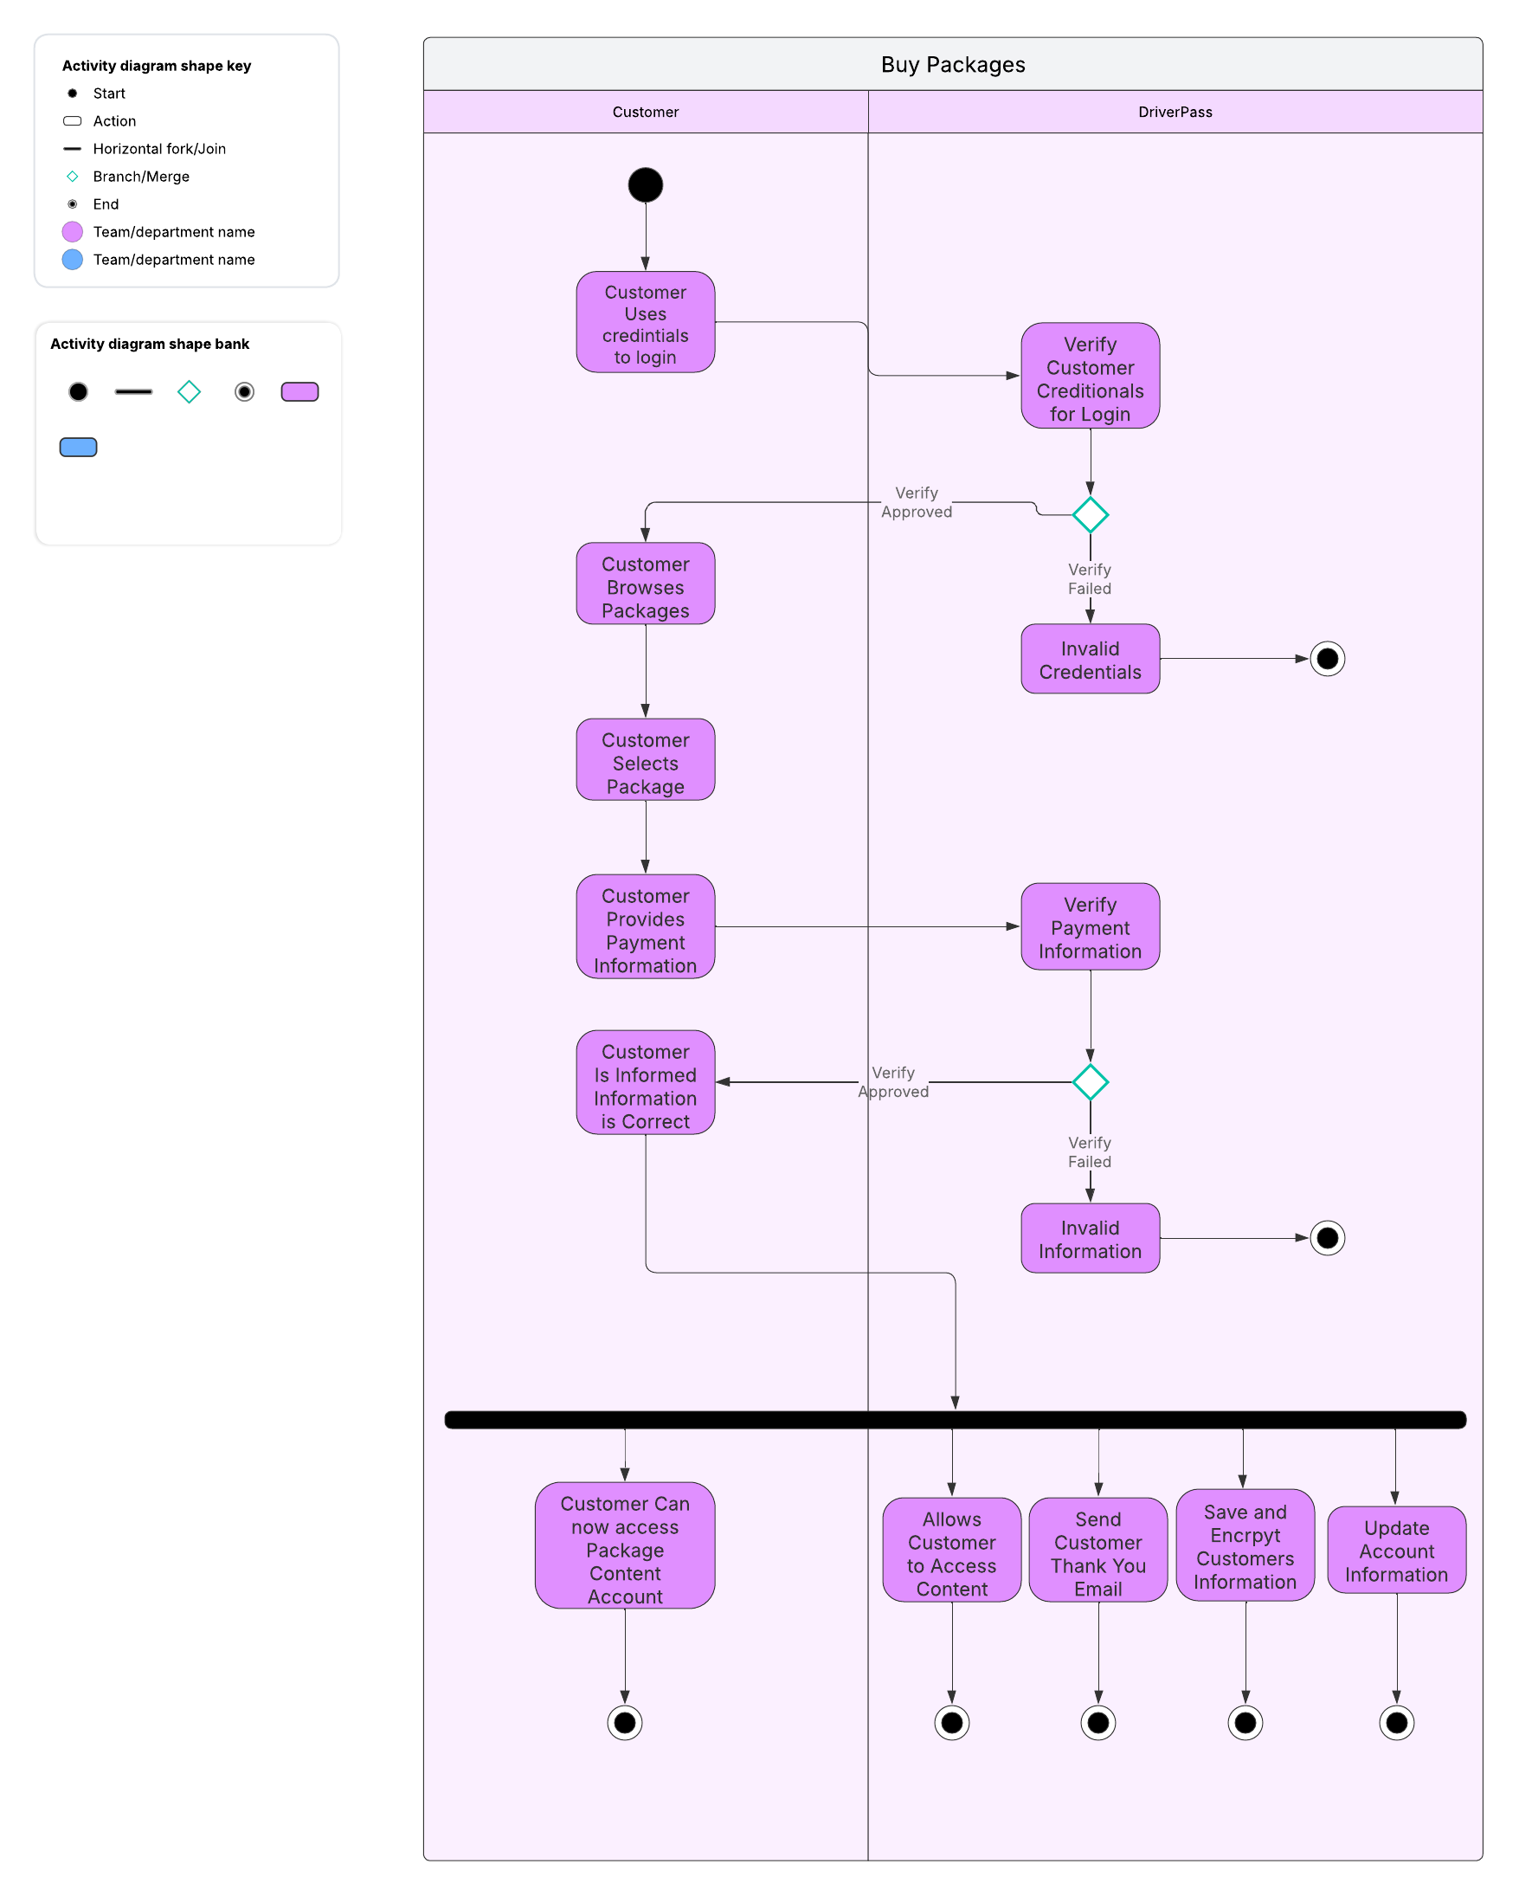
Activity Diagram
Notes:
[Explain your diagram. Which use case are you breaking down? What are the steps for this use case? How did you account for DriverPass’s needs in your design? In your explanation, keep your audience in mind. Avoid the use of technical terms such as “nodes,” “control flows,” and so on.]
Explain that this is a more in-depth process of how to specifically make just once piece of the software. Ensure you explain this is mainly for the technical team but to keep them in the know so you wanted to show they the diagram as well.
Explain that the diagram goes from start to finish. If you follow the line. Where it splits with the green triangle that means if. If it gets verified or if it doesn’t. Explain that the black bar means that happens all at the same time and the Black circle means stop.

Slide 5
Security
Data Protection
All Personal Information of user profiles are safe and secure
Safe Payment
Payment is done though a government secure part and is not though us so we can secure the upmost safety
Regular Updates
Systems update regularly to ensure safety
Account Monitoring
Accounts that have suspicious activity could be stopped before they cause harm
Profiles
All Users that can access the system only have access to what gives them clearance
Notes:
[How did you consider security in your design? In your explanation, keep your audience in mind by avoiding the use of technical terms.]
It’s important to explain this slide in nontechnical terms as well as show the emphasis of why it is extremely important. If they have alone, I will give you points to use to demonstrate the concept Data protection Image if your house had no front door and someone could just walk in and take whatever they want. That is that data protection prevents. Think of it as a front door that’s locked in a house full of goodies.
Safe Payment
alone, make sure everyone's money is safe the government handles all control over digital money which is the best case. We will assist the government in using their cards.
Regular Updates
Regular updates to the system is important as if you give people to much time alone, they can break into the system. Think of this like if you leave a prison with security guards on every Sunday. While the first few weeks or months may be ok. All it takes is for 1 person to notice and they can cause chaos.
Account Monitoring
Account Monitoring stops anything bad before it happens. For instance, if someone logs in and logs out quickly for 6 hours straight you can assume this is not human and it’s a bot someone programmed so you can safely ban their accounts. (if they STILL are worried about banning the wrong people explain to them that if you saw a person in a ski mask with a crowbar outside of their car you would think they are a burglar and ask them to leave the area with your car.)
Profiles Every user only gets certain access to what they should have at that level. For instance, you wouldn’t trust a 7-year-old to cook Dinner for everyone. It would be the same with trusting Customers to manage the entire system.

Slide 6
System Limitations
Internet dependency
Clients will need a stable Internet connection to use the system.
Device Compatibility
Older devices and browsers will not be supported which could alienate some customers.
Scalability
Scaling could be an issue in the future as it may slow down some aspects if not done correctly.
Security risk
Though our security will be top notch when you create a new type of lock there will always be people trying to pick it
Notes:
[What are the limitations of your design? In your explanation, keep your audience in mind by avoiding the use of technical terms.]
Explain that just like how you can’t expect everyone to like you. You can’t expect a program to work on everything
Device compatibility
is something that will be hard to explain but try explaining it as it’s a lot harder for older dogs to keep up with new dogs' tricks. Try your best to explain the technical terms of how when devices update the older parts of the system may not be there. For skyscraper if you're building a high skyscraper where everyone moves up a floor constantly there is no reason to keep the lower staircases. Which if our application uses the lower staircases, it might not work for those devices anymore.
Scalability
Scaling is just how large the business can grow. Explain that it might be harder to grow a business if you have 1 million bad workers instead of a few good workers
Security Risk
Explain that security will always be a concern no matter what you make. People will always try to find a way into anything they aren’t supposed to be in.

